Slide 1
OEM’s and The Aftermarket (IAM) A New Direction… Renewed Partnerships
ETI Tool Tech
April 18, 2012
Bob Augustine, Technical Training Mgr
Christian Brothers Automotive

Slide 2
Situational Awareness (SA)
Situation awareness, is the perception of environmental elements with respect to time and/or space, the comprehension of their meaning, and the projection of their status after some variable has changed, such as time. It is also a field of study concerned with perception of the environment critical to decision-makers in complex, dynamic areas from aviation, air traffic control, power plant operations, military command and control, and emergency services such as fire fighting and policing; to more ordinary but nevertheless complex tasks such as driving an automobile or bicycle.
Situation awareness involves being aware of what is happening in the vicinity to understand how information, events, and one's own actions will impact goals and objectives, both immediately and in the near future. Lacking or inadequate situation awareness has been identified as one of the primary factors in accidents attributed to human error.^{[1]} Thus, situation awareness is especially important in work domains where the information flow can be quite high and poor decisions may lead to serious consequences (e.g., piloting an airplane, functioning as a soldier, or treating critically ill or injured patients).
Having complete, accurate and up-to-the-minute SA is essential where technological and situational complexity on the human decision-maker are a concern. Situation awareness has been recognized as a critical, yet often elusive, foundation for successful decision-making across a broad range of complex and dynamic systems, including aviation and air traffic control,^{[2]} emergency response and military command and control operations,^{[3]} and offshore oil and nuclear power plant management

Slide 3
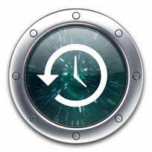
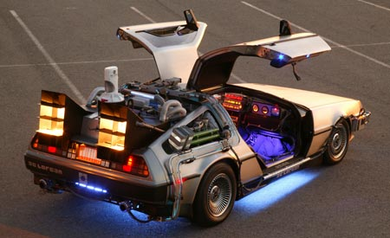
SA-Where We Were…

Slide 4
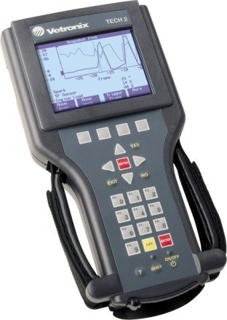
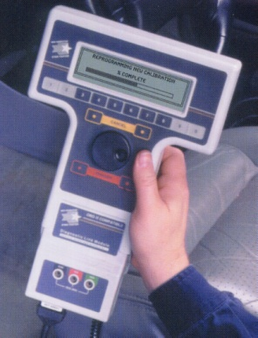
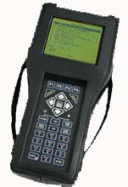
Diagnostics-2002
General Motors
Tech 2-Vetronix
J1850 VPW (Class 2)
Ford
NGS-Hickok
J1850 PWM (SCP)
Chrysler
DRBIII-OTC/SPX
J2610 (SCI)

Slide 5
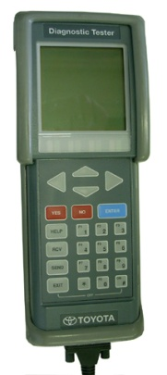
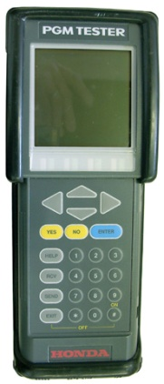
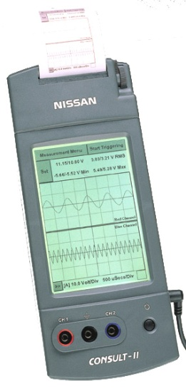
Diagnostics-2002
Toyota
Diagnostic Tester-Vetronix
ISO9141-2
Honda
PGM/FI-Vetronix
ISO9141-2
Nissan
Consult II-Vetronix
ISO9141-2

Slide 6
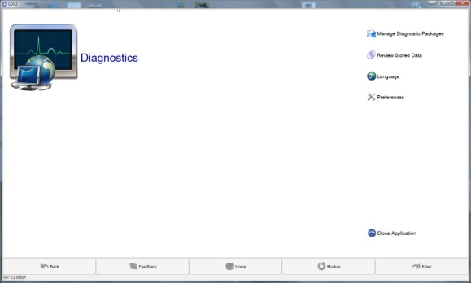
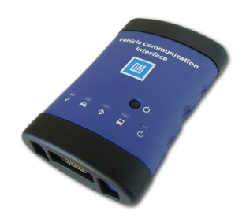
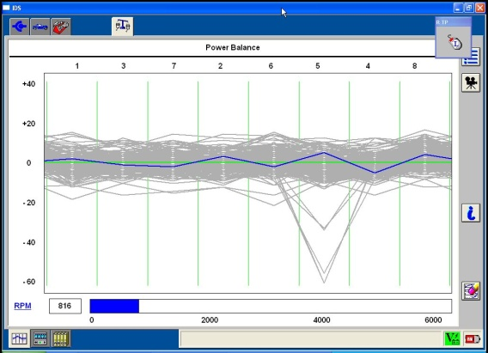
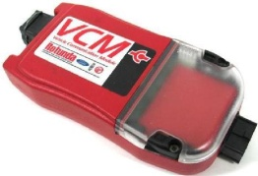
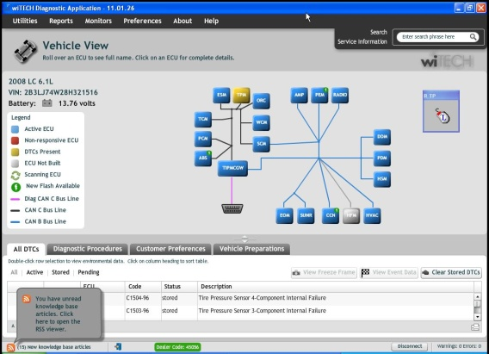
Diagnostics-2012
General Motors
MDI-ETAS (Bosch)
GDS2
ISO15765-4
Ford
VCM/VCMII (Teradyne, SPX, Bosch)
IDS
ISO15765-4
Chrysler
WiTech (Bright Star)
WiTech
ISO15765-4

Slide 7
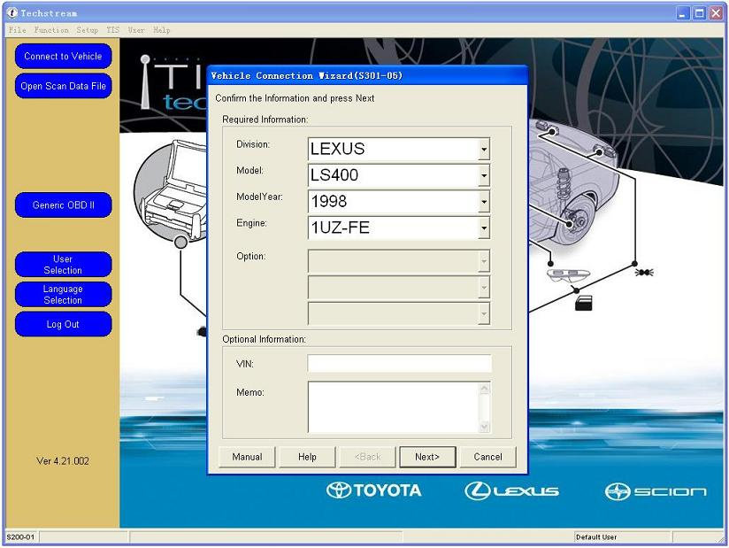
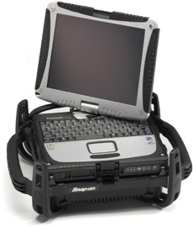
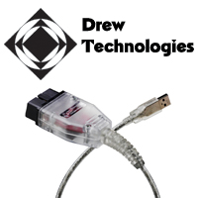
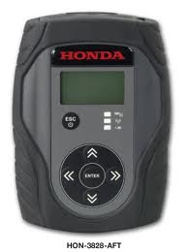
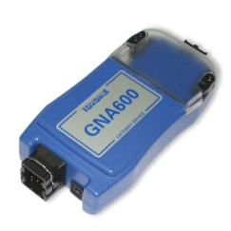
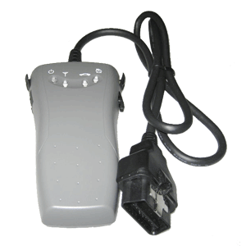
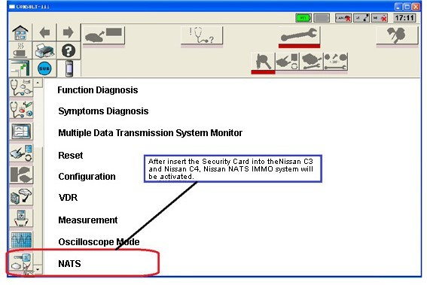
Diagnostics-2012
Toyota
VCM/J2534
Techstream
ISO15765-4
Honda
MVCI (SPX)
HDS
ISO15765-4
Nissan
Consult III
Consult III
ISO15765-4

Slide 8
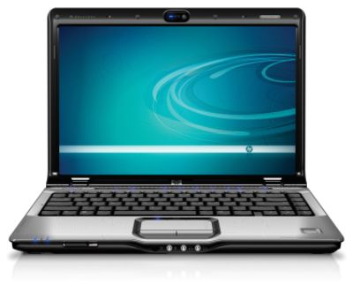
Undeniable Trends:
Standardized communication protocols
Migration from embedded device to PC platform in software
Tethered to wireless
Hardware specs but not mandatory req’s
VIN-based diagnostics
DTCs
Linked service information
Real-time calibration availability
“Real-world” fix databases (Identifix)
2B3LJ74W28H321516

Slide 9
What’s Broken (& needs to be fixed or improved?)
Distribution
In most cases, software and hardware is single source (OEM normally has a third party admin)
Lack of competition creates poor service model
Recommend: Open up channels
Technical Support
In most cases, you cannot speak to a human being
Recommend: Contract a company familiar with both the hardware and software to support IAM
Hardware Isolationism
Too many proprietary hardware platforms.
Recommend: Industry-standard hardware (J-2534, ISO-22900)
Website Navigation
Most OEM repair sites are poorly designed, not logical
Recommend: Focus groups with non-IT folks to streamline navigation (maybe some techs?)

